Slide 1
MongoDB – Overview
April 2016

Slide 2
Version Sheet: MANDATORY (hidden in ‘slide show’ mode)
Version | Changes | Author
001 | Redesign | Rohan Salvi

Slide 3
Note to the SME:
Note to the SME:
This is a temporary slide and will not be part of the final upload at all. It is to help the SME understand how we will communicate changes to them.
Please read before you begin reviewing this module as SME
Dark Red box with white text
Note to the SME
The SME must provide missing info.
Amber box with black text
Note to the SME
The SME must validate the re-design/ the modification/ addition.
To Review and Navigate the comments in the presentation Click on the “Review” Tab and then Click “Next” to review all the comments . Also you can add your comments using the “New comment” button
The comments in the review section have also been updated in a green textbox with black text.
.

Slide 4
Ground Rules for Face-to-face Classrooms
Everyone participates
Respect individual opinions and diversities
Be open and honest
Give headlines, be concise
One speaker at a time
Make language a non-issue
Stick to time contracts
Seek first to understand, and then to be understood
Clean desk / room policy
No mobile phone,
No computer (except for surveys, polls etc)
Clients & Leadership are often around, please remember that
Maintain a spirit of fun and enthusiasm
Notes:
Best to print on an A3 sheet and display in class. The idea is to co-create, to connect to learn, to do-learn-do (knowing is not enough, the real purpose is to apply what we learn on the job). It would also be great to have the class share their learning with their teams. You are the facilitator, you will help all share knowledge and learn new concepts or skills, there will be no lectures, everyone is a teacher.

Slide 5

Ground Rules for Virtual Classrooms
Wait for others to finish speaking before you speak
Each time you speak, state your name
Build on others’ ideas and thoughts
Disagreeing is OK –with respect and courtesy
Participate actively in each session
Share experiences and best practices
Bring up challenges, ask questions
Discuss successes
Respond to whiteboards, polls, quizzes, chat boxes
Hang up if you need to take an urgent phone call, don’t put this call on hold
As a best practice…be just a few minutes early!
Communicate professionally with others
Mute when you’re not speaking
Be on time for each virtual session
Notes:
Show this slide and hide the one for onsite classrooms, if this is a virtual session.
ONLY for Virtual classrooms

Slide 6
Module at a Glance
SME to provide the details required in the table.
Target Audience:
Course Level: | Basic
Duration (in hours): | 30 mins
Pre-requisites, if any: | NA
Post-requisites, if any: | Submit Session Feedback
Relevant Certifications: | None

Slide 7
Introductions (for Virtual Classrooms)
SME to provide the photos and names of the facilitators.
Business Photo
Business Photo
Facilitator
Name
Role
Moderator
Name
Role
Notes:
Add pics and Capgemini roles for the Facilitator and moderator. Establish their credibility, what qualifies them to facilitate this session.

Slide 8
Agenda
NOSQL Introduction & Types
1
Introduction & Basics
2
CRUD
3
Aggregation
4
Indexes
5
Performance
6
Replication & Sharding
7

Slide 9


Module Objectives
Note to the SME : Please provide the module Objectives or validate the partially updated content
What you will learn
At the end of this module, you will learn:
What is NOSQL
What you will be able to do
At the end of this module, you be able to:
Understand what is NOSQL
Describe CRUD
State the types of NOSQL
Explain what is Aggregation
Describe Replication & Sharding

Slide 10

Lets Get Social

Slide 11
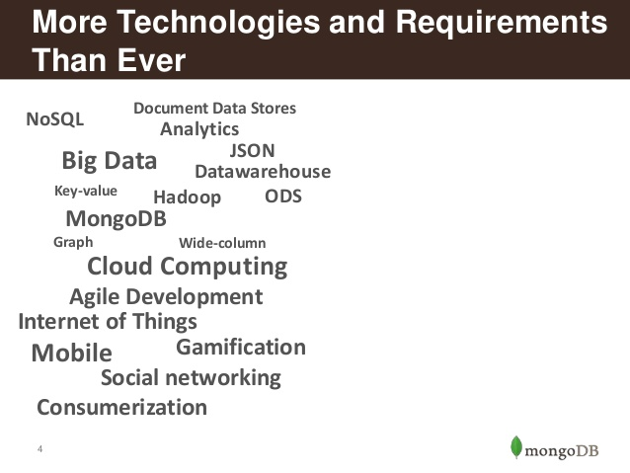
More Technologies

Slide 12
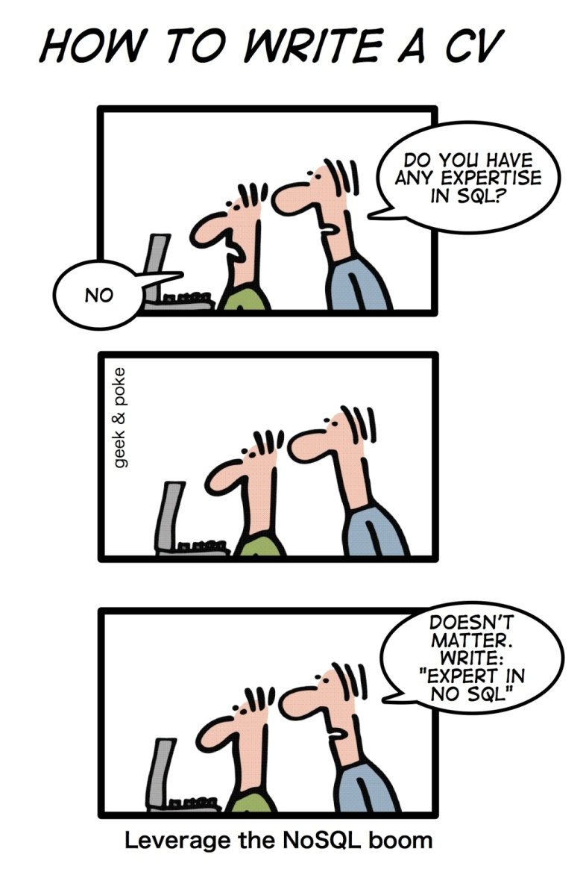
Boom of NOSQL

Slide 13
Why NoSQL
Handles Schema Changes Well (easy development)
Solves Impedance Mismatch problem
Rise of JSON
python module: simplejson

Slide 14
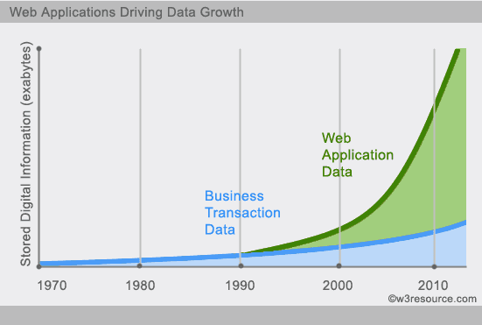
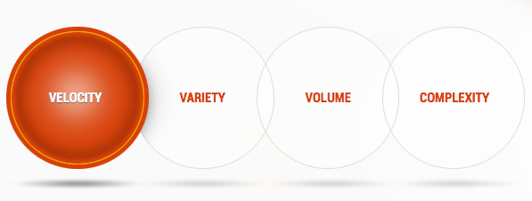
NO SQL (or) BIG Data Envt

Slide 15
Example 1
Social Network Graph
Each record: UserID1, UserID2
Separate records: UserID, first_name,last_name, age, gender,...
Task: Find all friends of friends of friends of ... friends of a given user

Slide 16
Example 2
Wikipedia Pages
Task: Retrieve all pages regarding athletics of Summer Olympic before 1950
Combination of structured and unstructured data
Large collection of documents

Slide 17
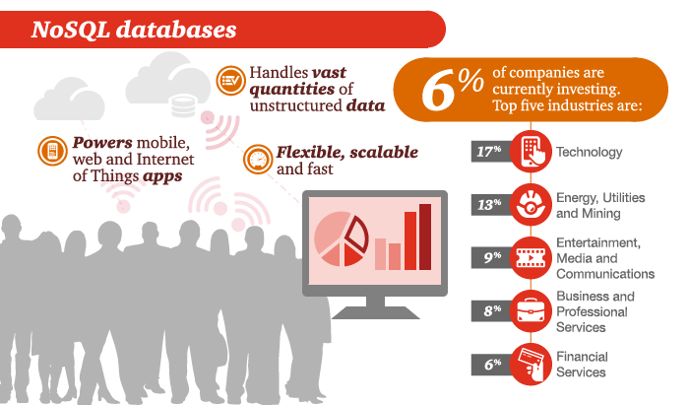
NOSQL Market

Slide 18
What is NoSQL?
Stands for ‘Not Only SQL’.
Originally refers to “non SQL” or “non Relational” database.
Term coined by Carlo Strozzi in 1998.
Open Source.
No Rows-Columns / Tables.
No Predefined schema.
Eventually consistency rather than ACID property.
Distributed computing.
Unstructured and unpredictable data.
Prioritizes high scalability ,high availability and scalability.
Replication support .

Slide 19
NoSQL Database Types
Key-value
Graph database
Document-oriented
Column family
Notes:
Huge quantity of data => Distributed systems => expensive joins =>
New fields, new demands (graphs) =>
Different data strucutres:
Simplier or more specific

Slide 20
CAP Theorem
Consistency
This means that the data in the database remains consistent after the execution of an operation. For example after an update operation all clients see the same data.
Availability
This means that the system is always on (service guarantee availability), no downtime.
Partition Tolerance
This means that the system continues to function even the communication among the servers is unreliable, i.e. the servers may be partitioned into multiple groups that cannot communicate with one another.

Slide 21
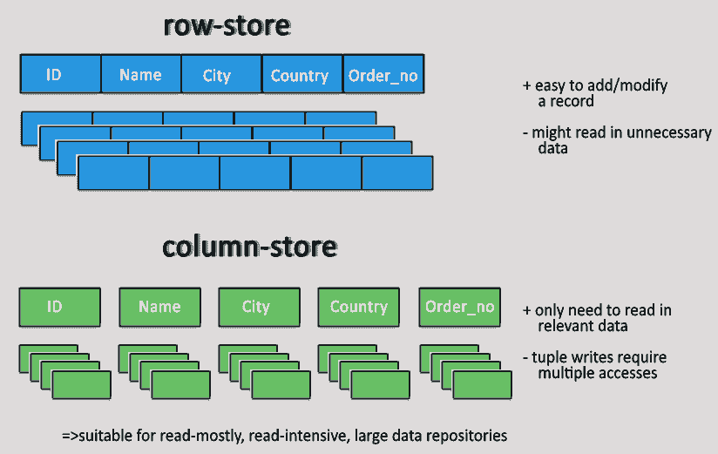
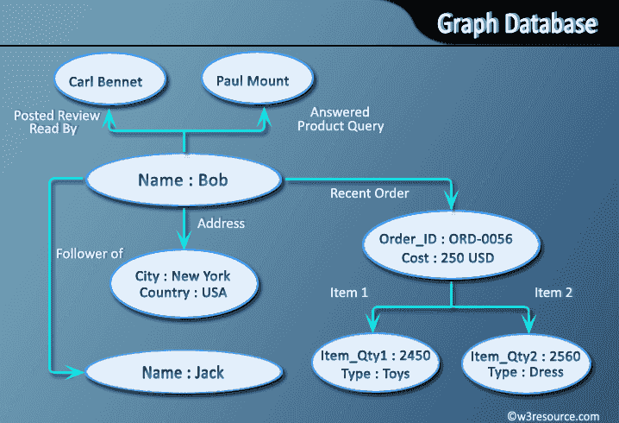
NO SQL Databases Types
Key Value Stores
Graph Database

Slide 22
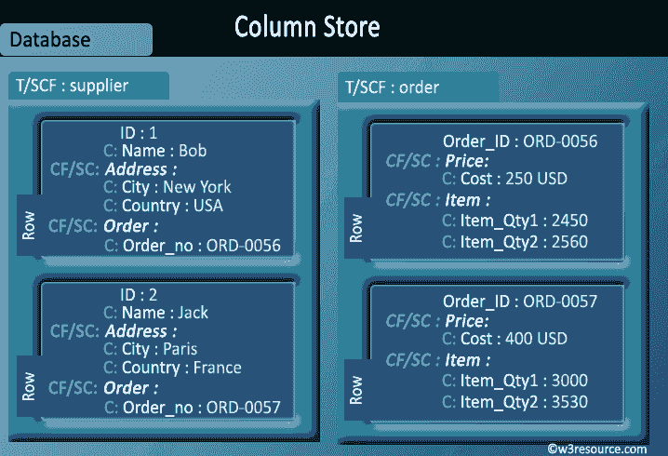
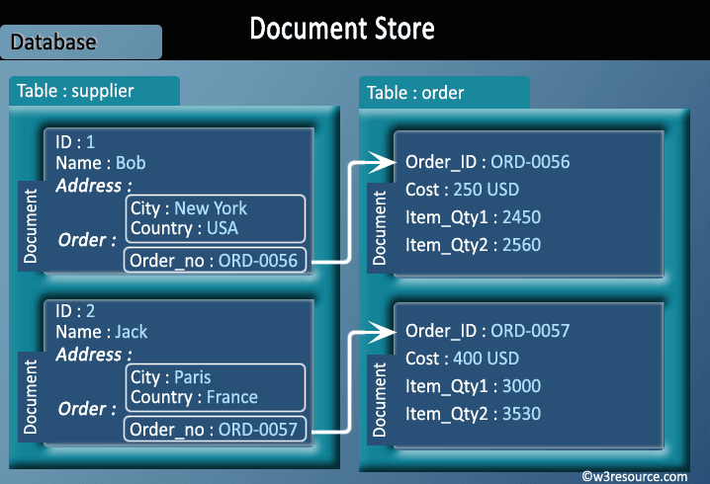
Types of NoSQL Databases
Wide Column Store
Document Store

Slide 23
Production Deployment
Google
Facebook
Mozilla
Adobe
Foursquare
LinkedIn
Digg
McGraw-Hill Education
Vermont Public Radio

Slide 24

MongoDB Introduction

Slide 25
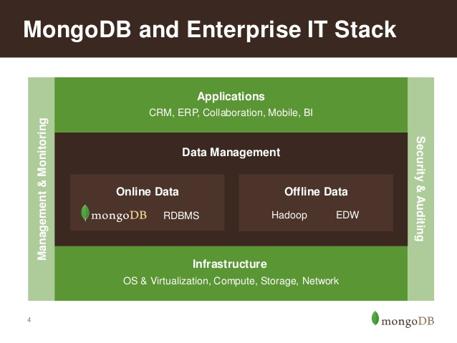
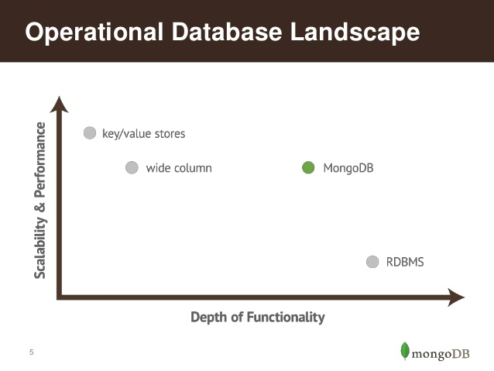
MongoDB Philosophy

Slide 26
What is MongoDB
MongoDB (from humongous) is a cross-platform document oriented database
Schema-free document database
Nosql database
Written in C++
Open-source project that mainly driven by 10gen Inc.
10gen Inc. also offers professional services around MongoDB
Has driver to all most every popular language programming
Notes:
MongoDB (from humongous) is a cross-platform document oriented database . Classified as a NoSQL database, MongoDB eschews the traditional table-based relational database structure in favor of JSON -like documents with dynamic schemas (MongoDB calls the format BSON), making the integration of data in certain types of applications easier and faster. Released under a combination of the GNU Affero General Public License and the Apache License, MongoDB is free and open-source software
MongoDB stores data in the form of documents, which are JSON-like field and value pairs.
Documents are analogous to structures in programming languages that associate keys with values (e.g. dictionaries, hashes,
maps, and associative arrays).
Formally, MongoDB documents are BSON documents. BSON is a binary representation of JSON with additional type information. In the documents, the value of a field can be any of the BSON data types, including other documents, arrays, and arrays of documents

Slide 27
MongoDB is:
General Purpose
Rich data model
Full featured indexes
Sophisticated query language
Easy to Use
Easy mapping to object oriented code
Native language drivers in all popular languages
Simple to setup and manage
Operates at in-memory speed wherever possible
Auto-sharding built in
Dynamically add / remove capacity with no downtime
Fast & Scalable

Slide 28
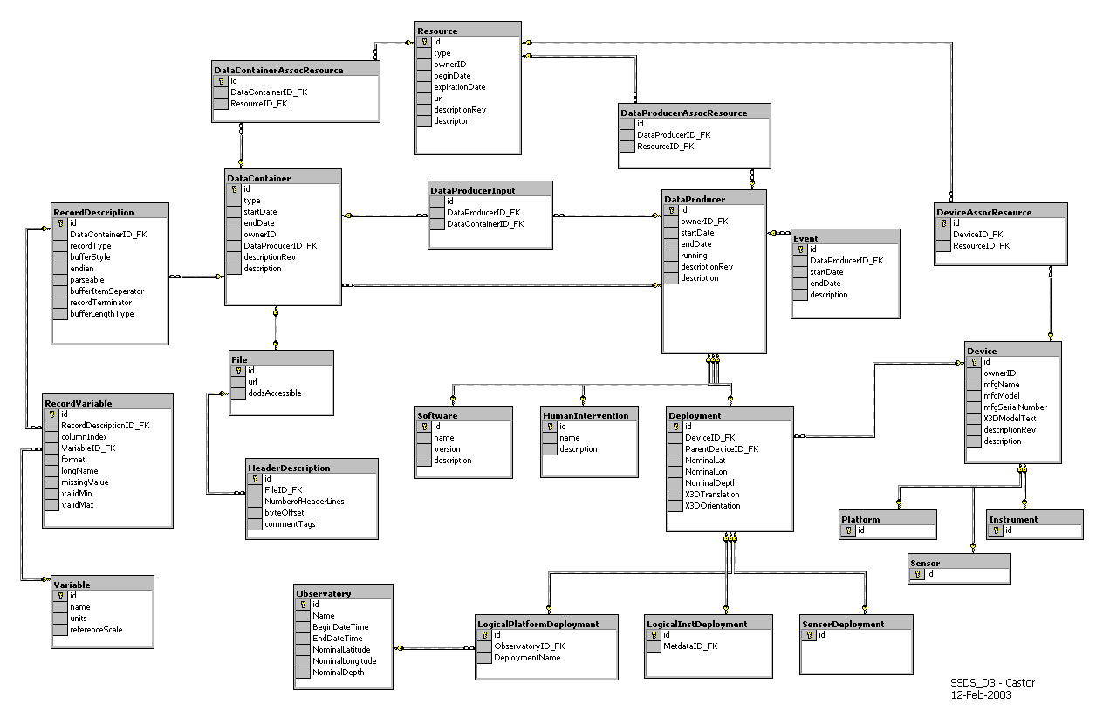
MongoDB is Easy to Use
{
title: ‘MongoDB’,
contributors: [
{ name: ‘Eliot Horowitz’,
email: ‘eliot@10gen.com’ },
{ name: ‘Dwight Merriman’,
email: ‘dwight@10gen.com’ }
],
model: {
relational: false,
awesome: true
}
}

Slide 29

Schema Free
MongoDB does not need any pre-defined data schema.
Every document could have different data!
{name: “will”,
eyes: “blue”,
birthplace: “NY”,
aliases: [“bill”, “la ciacco”],
loc: [32.7, 63.4],
boss: ”ben”}
{name: “jeff”,
eyes: “blue”,
loc: [40.7, 73.4],
boss: “ben”}
{name: “brendan”,
aliases: [“el diablo”]}
{name: “matt”,
pizza: “DiGiorno”,
height: 72,
loc: [44.6, 71.3]}
{name: “ben”,
hat: ”yes”}
Notes:
Applications enforce the data “schema” and integrity, much like MUMPS does in VistA

Slide 30


MongoDB is Fast and Scalable
Better data locality
In-Memory
Caching
Distributed Architecture
Replication /HA
Relational
MongoDB
Horizontal Scaling

Slide 31
History
Jan 2015
2.6.7
3.0
2009
C++
10gen
HUMONGOUS
2007

Slide 32
Features of MongoDB
Document Oriented Database
Adhoc queries
Indexing
High Performance
High Availability
Sharding
Easy Scalability
File Storage
Rich Query Language
Load Balancing
Replication
Notes:
Document-oriented
Documents (objects) map nicely to programming language data types
Embedded documents and arrays reduce need for joins
Dynamically-typed (schemaless) for easy schema evolution
No joins and no multi-document transactions for high performance and easy scalability
High performance
No joins and embedding makes reads and writes fast
Indexes including indexing of keys from embedded documents and arrays
Optional streaming writes (no acknowledgements)
High availability
Replicated servers with automatic master failover
Easy scalability
Automatic sharding (auto-partitioning of data across servers)
Reads and writes are distributed over shards
No joins or multi-document transactions make distributed queries easy and fast
Eventually-consistent reads can be distributed over replicated servers
Rich query language

Slide 33
Where should you use Mongodb
Big Data
Content Management and Delivery
Mobile and Social Infrastructure
User Data Management
Data Hub
Notes:
Document-oriented
Documents (objects) map nicely to programming language data types
Embedded documents and arrays reduce need for joins
Dynamically-typed (schemaless) for easy schema evolution
No joins and no multi-document transactions for high performance and easy scalability
High performance
No joins and embedding makes reads and writes fast
Indexes including indexing of keys from embedded documents and arrays
Optional streaming writes (no acknowledgements)
High availability
Replicated servers with automatic master failover
Easy scalability
Automatic sharding (auto-partitioning of data across servers)
Reads and writes are distributed over shards
No joins or multi-document transactions make distributed queries easy and fast
Eventually-consistent reads can be distributed over replicated servers
Rich query language

Slide 34
MongoDB to SQL Terminology
MongoDB | SQL
database | database
collection | table
document | record (row)
field | column
linking/embedded documents | join
primary key (_id field) | primary key (user designated)
index | index

Slide 35
Important Terminology
Database
Database is a physical container for collections. Each database gets its own set of files on the file system. A single MongoDB server typically has multiple databases.
Collection
Collection is a group of MongoDB documents. It is the equivalent of an RDBMS table. A collection exists within a single database. Collections do not enforce a schema. Documents within a collection can have different fields. Typically, all documents in a collection are of similar or related purpose.
Document
A document is a set of key-value pairs. Documents have dynamic schema. Dynamic schema means that documents in the same collection do not need to have the same set of fields or structure, and common fields in a collection's documents may hold different types of data.

Slide 36
MongoDB ‘s Data Model
A Database has “Collections”
Collections have “Documents”
Documents have “Fields”
Fields are key = value pairs

Slide 37
Data Model
Document based (max 16 MB).
Documents are in BSON formats consisting of field / value pairs.
Each document stored in a collection.
Schema less.

Slide 38
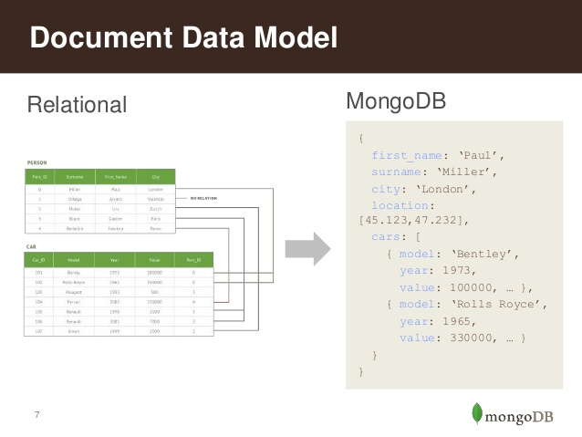
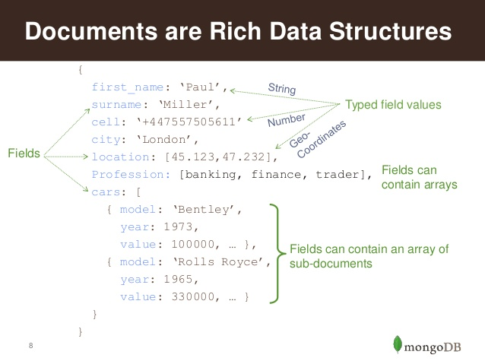
Data Model

Slide 39
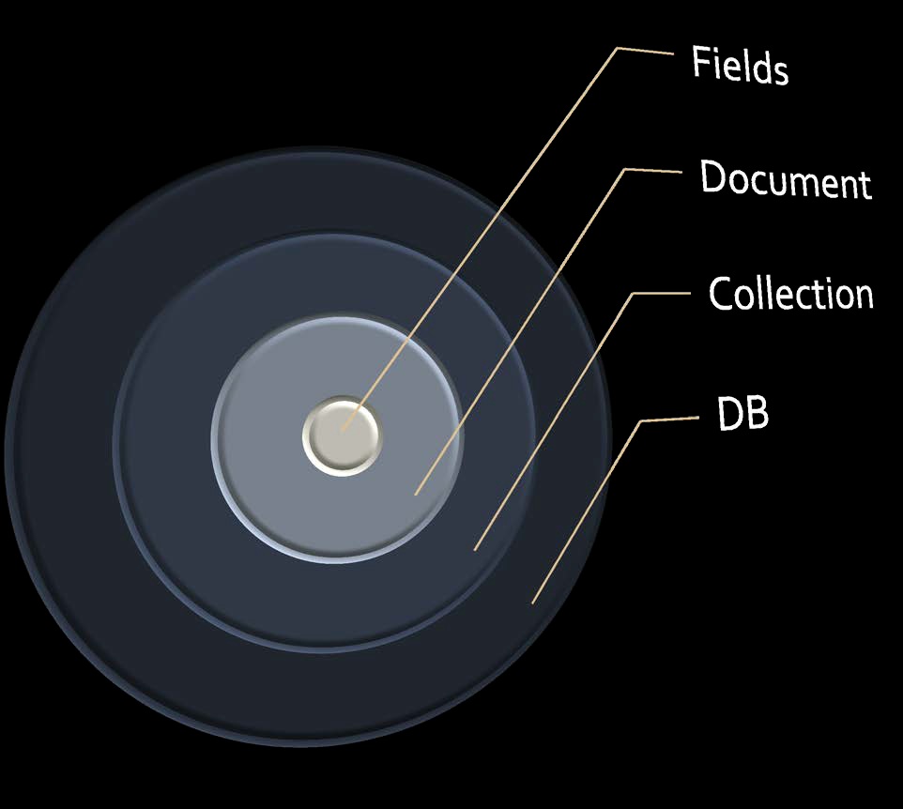
MongoDB Data Model

Slide 40
The Basics of MongoDB
A MongoDB instance may have one or more Databases.
A database may have one or more Collections.
A collection may have zero or more Documents.
A document may have one or more Fields.
MongoDB indexes function much like their RDBMS counterparts.

Slide 41
Database Server and Client
mongod
server
mongo
client

Slide 42
Getting Started
Install mongodb on windows from the link given below:
http://www.mongodb.org/downloads
Make sure you get correct version of MongoDB depending upon your windows version.
MongoDB for Windows 64-bit: This build type of MongoDB runs on any 64-bit version of Windows latest than Windows XP, involve Windows Server 2008 R2 and Windows 7 64-bit.

Slide 43
What MongoDB does, How it works
MongoDB is a server process that runs on Windows/Linux , Os X.
It can be run both as a 32 or 64-bit application. We recommend running in 64-bit mode, since Mongo is limited to a total data size of about 2GB for all databases in 32-bit mode.
Clients connect to the MongoDB process, optionally authenticate themselves if security is turned on, and perform a sequence of actions, such as inserts, queries and updates.

Slide 44
Starting the MongoDB Server
Create a directory where MongoDB stores all its data.
The MongoDB default data directory path is \data\db.
Create the data folder in D:\
Set the Path.
Run mongod.exe
To start MongoDB server, we need to run mongod.exe

Slide 45
Starting the MongoDB Server (contd.)
D:\set up\mongodb>mongod.exe --dbpath "d:\set up\mongodb\data"
This will show waiting for connections message on the console output indicates that the mongod.exe process is running successfully.
Now to run the mongodb you need to open another command prompt and issue the following command.

Slide 46
Starting the MongoDB Server (contd.)
D:\set up\mongodb\bin>mongo.exe
MongoDB shell version: 2.2.0
connecting to: test
Welcome to the MongoDB shell

Slide 47
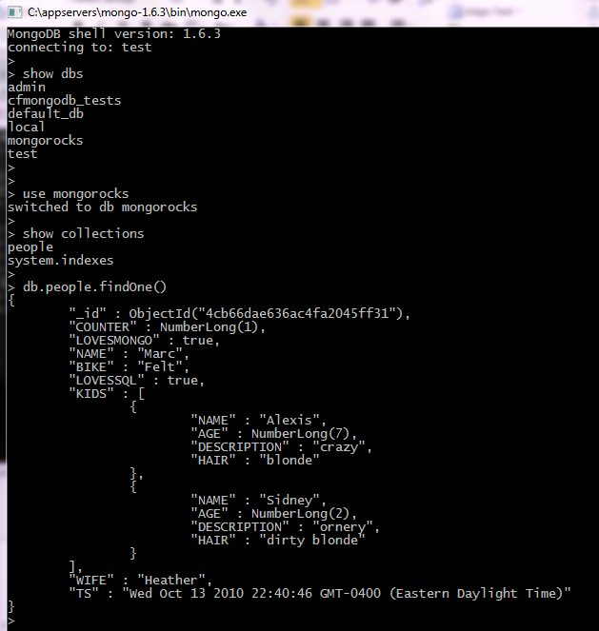
The Mongo Shell
D>mongo
>help()
>show dbs
>use <dbname>
>show collections
>db.collectionName.findOne()
>db.collectionName.find()
>db.help()
>db.collectionName.help()

Slide 48
Summary
What is NOSQL database
Advantages of NOSQL
Why MongoDB
MongoDB Document database
MongoDB data model
Mongo Shell
Establishing Connection
Understand about Collection, document and fields

